Slide 1

Tea Leaves Disease Prediction using CNN with vgg16
Name:Kalyan Chakravarthy
Registration Number: 21BAI1759
Course: Machine Vision

Slide 2
Introduction
This project aims to address the critical challenge of early detection of tea leaf diseases through the implementation of a deep learning model. The conventional methods of disease detection, primarily reliant on visual inspection, have proven to be time-consuming and prone to inaccuracies. In response to this,This project proposes the development and deployment of a deep learning model based on a Convolutional Neural Network (CNN). This model is designed to identify various diseases affecting tea leaves efficiently and accurately. By leveraging a labelled dataset of tea leaf images encompassing both healthy and diseased specimens, the CNN will be trained to distinguish and categorize different types of diseases. The overarching goal is to streamline the detection process, providing a reliable tool for tea farmers to identify and mitigate diseases promptly.
Convolutional neural networks (CNNs) will be employed to learn discriminative features directly from images, optimizing architectures and parameters for superior performance. Rigorous validation will assess accuracy, with emphasis on challenging scenarios.

Slide 3
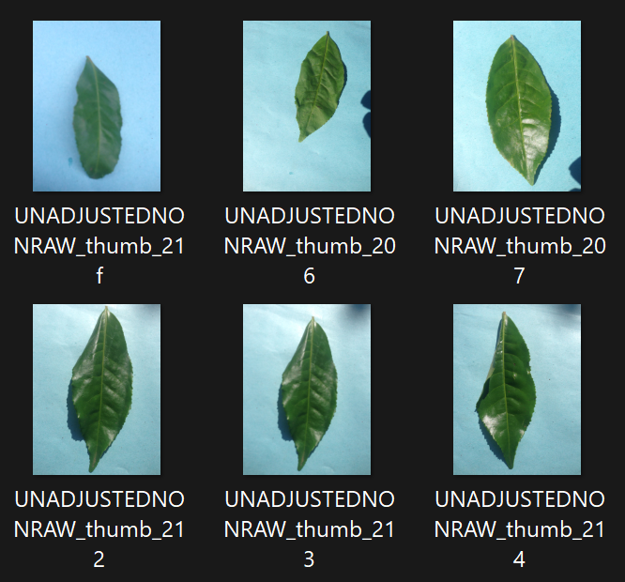
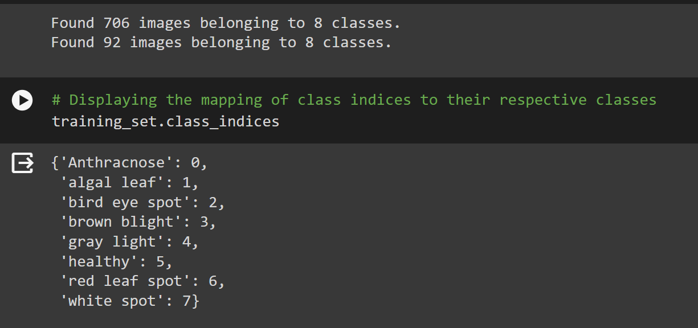
Distribution of the Classes
The dataset utilized in this study comprises Tea Leaf images sourced from the Tea leaf image dataset. This dataset is organized into three main directories: train, test, and validation.
Each directory contains subdirectories corresponding to the classes of interest: 8 types. These classes represent the disease of leaf in tea leaf images, thus constituting a multi classification problem.
This results in an imbalance in the dataset.
We solve this imbalance by augmenting the dataset for increasing the number of images and decreasing the imbalance.

Slide 4
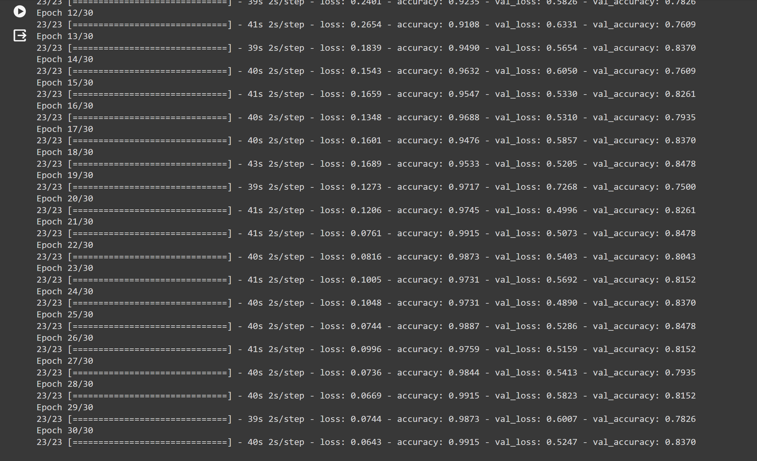
Results
We have trained the model with emphasis on Accuracy score as the model’s metrics,
The training Accuracy after training for 30 epochs has reached 0.9915 and the loss in the training data is at 0.0643.
The validation Accuracy has reached 0.83.70 and validation loss is at 0.5247

Slide 5
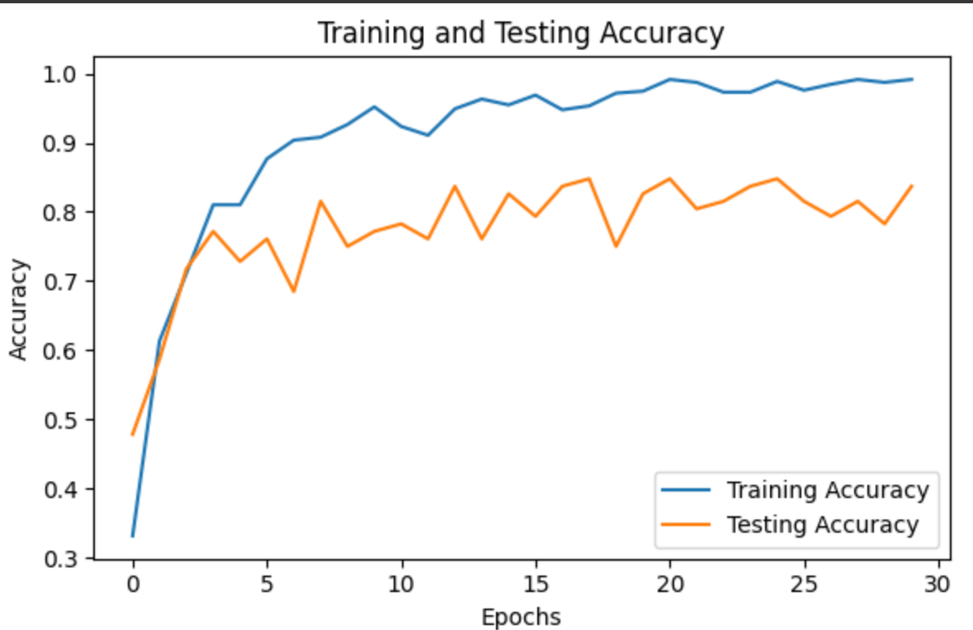
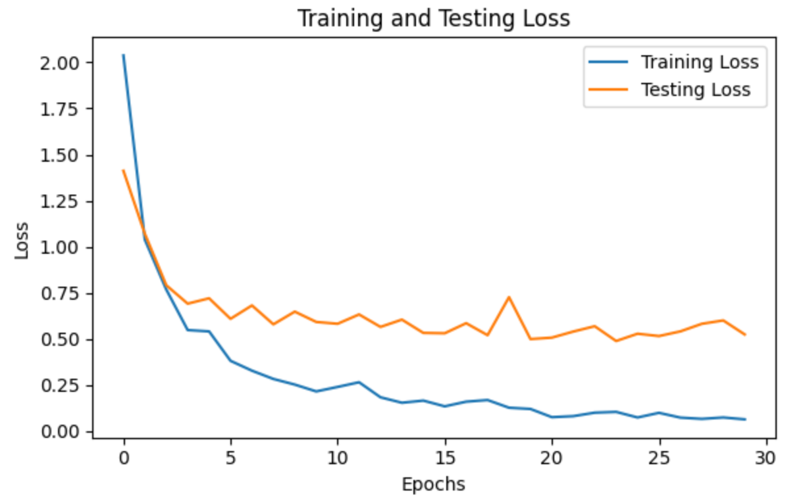
Graphs of Loss and Accuracy Over the Epochs
Curve shows Accuracy stability or increase over epochs, reflecting the model's ability to distinguish between classes.
Graph depicts the model's decreasing loss over 30 epochs, indicating improved accuracy as training progresses.

Slide 6
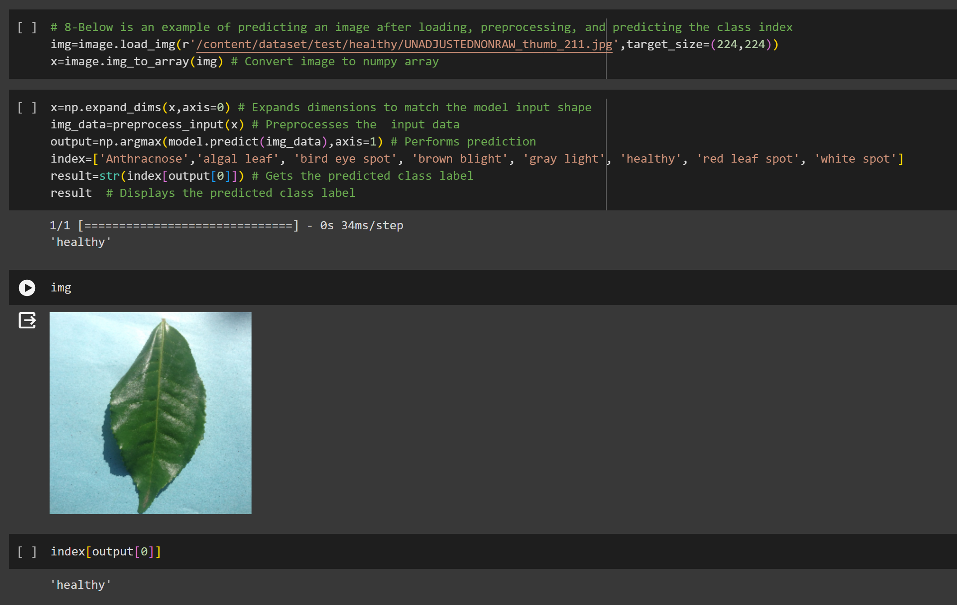
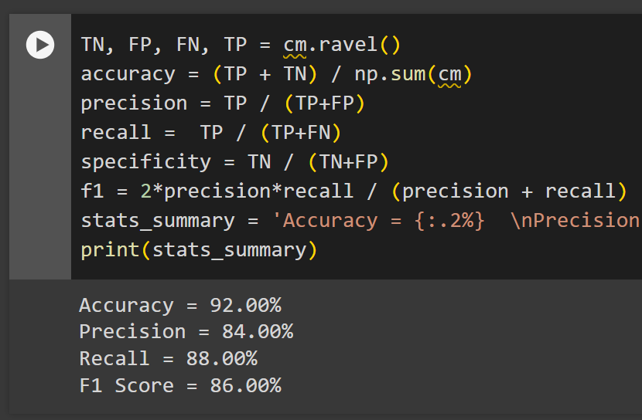
Model Output
Output:
Results of our model

Slide 7
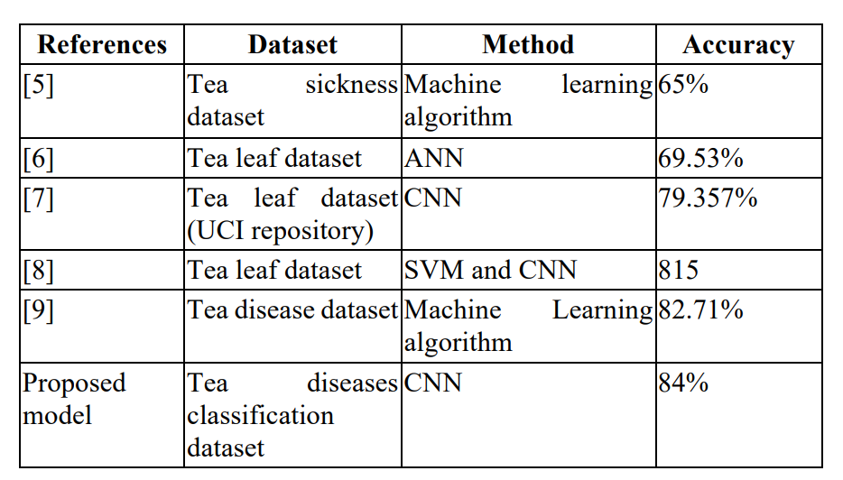
Comparison with other Papers
Referance paper 1 : https://ieeexplore.ieee.org/document/10263835
In this paper the highest accuracy is at 84%
In our model we have achieved 90% accuracy
In all the cases our model is equal to or if not greater than the one in the given research paper.
Results in the Paper
Results of Our Model

Slide 8
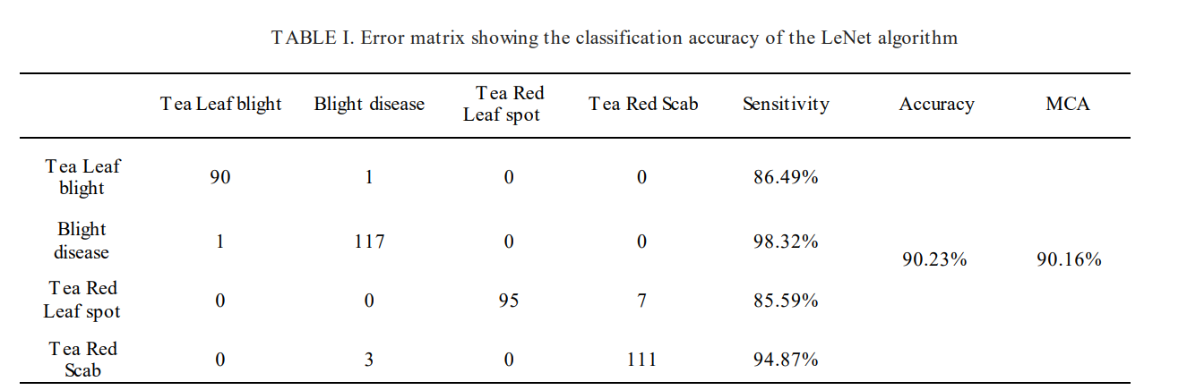
Reference paper 2 : https://ieeexplore.ieee.org/document/10169680
Results in the Paper
In this paper the accuracy is only at 90.16%
In our model we have achieved 92% accuracy
Our model has higher accuracy compared the paper’s accuracy
Our model has higher accuracy compared the paper’s validation accuracy.

Slide 9
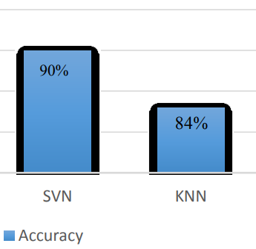
Reference paper 3 : https://ieeexplore.ieee.org/document/9155850
VGG16 got higher accuracy tan SVN and KNN
The disease characterization achieved by the CNN model falls short of 100% accuracy, future tests may incorporate improvements to the current approach. Nonetheless, the CNN model has so far produced the most accurate findings with an accuracy of 92%
The higher accuracy of the proposed model can do more help in practical application.

Slide 10
Thank You

